Slide 1
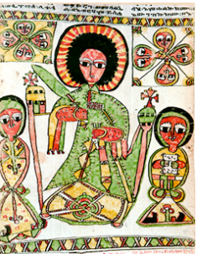
Transfiguration of Jesus
March 2, 2014

Slide 2

The game plan
Read the transfiguration of Jesus
Talk about what God Is Still Speaking means
Learn about the Christ figure in Literature
Talk about what the authors are trying to communicate
Talk about what you would write
Talk about future plans

Slide 3
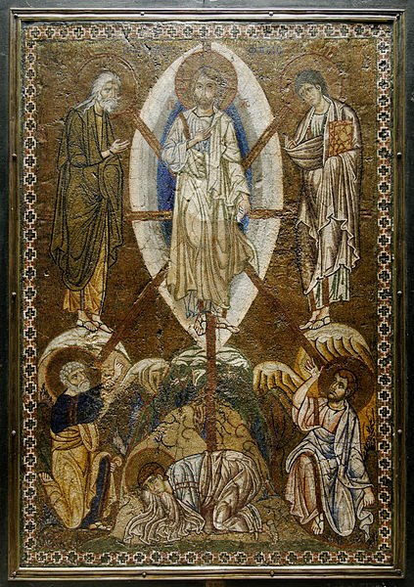
The transfiguration
The Synoptic Gospels
Matthew 17:1–9
Mark 9:2-8
Luke 9:28–36
2 Peter 1:16–18
Notes:
¹ And after six days Jesus taketh with him Peter, and James, and John his brother, and bringeth them up into a high mountain apart:
² and he was transfigured before them; and his face did shine as the sun, and his garments became white as the light.
³ And behold, there appeared unto them Moses and Elijah talking with him.
⁴ And Peter answered, and said unto Jesus, Lord, it is good for us to be here: if thou wilt, I will make here three tabernacles; one for thee, and one for Moses, and one for Elijah.
⁵ While he was yet speaking, behold, a bright cloud overshadowed them: and behold, a voice out of the cloud, saying, This is my beloved Son, in whom I am well pleased; hear ye him.
⁶ And when the disciples heard it, they fell on their face, and were sore afraid.
⁷ And Jesus came and touched them and said, Arise, and be not afraid.
⁸ And lifting up their eyes, they saw no one, save Jesus only.
⁹ And as they were coming down from the mountain, Jesus commanded them, saying, Tell the vision to no man, until the Son of man be risen from the dead.
² And after six days Jesus taketh with him Peter, and James, and John, and bringeth them up into a high mountain apart by themselves: and he was transfigured before them;
³ and his garments became glistering, exceeding white, so as no fuller on earth can whiten them.
⁴ And there appeared unto them Elijah with Moses: and they were talking with Jesus.
⁵ And Peter answereth and saith to Jesus, Rabbi, it is good for us to be here: and let us make three tabernacles; one for thee, and one for Moses, and one for Elijah.
⁶ For he knew not what to answer; for they became sore afraid.
⁷ And there came a cloud overshadowing them: and there came a voice out of the cloud, This is my beloved Son: hear ye him.
⁸ And suddenly looking round about, they saw no one any more, save Jesus only with themselves.
²⁸ And it came to pass about eight days after these sayings, that he took with him Peter and John and James, and went up into the mountain to pray.
²⁹ And as he was praying, the fashion of his countenance was altered, and his raiment [became] white [and] dazzling.
³⁰ And behold, there talked with him two men, who were Moses and Elijah;
³¹ who appeared in glory, and spake of his decease which he was about to accomplish at Jerusalem.
³² Now Peter and they that were with him were heavy with sleep: but when they were fully awake, they saw his glory, and the two men that stood with him.
³³ And it came to pass, as they were parting from him, Peter said unto Jesus, Master, it is good for us to be here: and let us make three tabernacles; one for thee, and one for Moses, and one for Elijah: not knowing what he said.
³⁴ And while he said these things, there came a cloud, and overshadowed them: and they feared as they entered into the cloud.
³⁵ And a voice came out of the cloud, saying, This is my Son, my chosen: hear ye him.
³⁶ And when the voice came, Jesus was found alone. And they held their peace, and told no man in those days any of the things which they had seen.
¹⁶ For we did not follow cunningly devised fables, when we made known unto you the power and coming of our Lord Jesus Christ, but we were eyewitnesses of his majesty.
¹⁷ For he received from God the Father honor and glory, when there was borne such a voice to him by the Majestic Glory, This is my beloved Son, in whom I am well pleased:
¹⁸ and this voice we [ourselves] heard borne out of heaven, when we were with him in the holy mount.

Slide 4

Background
Central Premise of Our Church

Slide 5


Slide 6
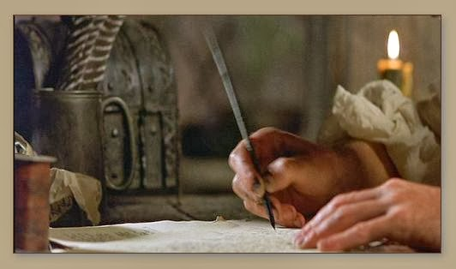
Does it mean:
God is still writing books?
Notes:
Is the following divinely inspired (You might notice it from Apple commercial)
O ME! O LIFE! O ME! O life! of the questions of these recurring, Of the endless trains of the faithless, of cities fill'd with the foolish, Of myself forever reproaching myself, (for who more
foolish than I, and who more faithless?) Of eyes that vainly crave the light, of the objects mean,
of the struggle ever renew'd, Of the poor results of all, of the plodding and sordid
crowds I see around me,
140LEAVES OF GRASS. Of the empty and useless years of the rest, with the rest me intertwined, The question, O me! so sad, recurring—What good
amid these, O me, O life?
Answer. That you are here—that life exists and identity, That the powerful play goes on, and you may contribute a verse.

Slide 7
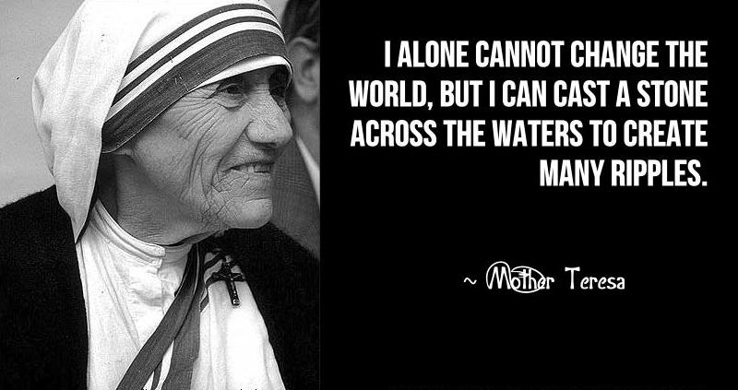
God is still inspiring people?
Notes:
Mother Teresa
Martin Luther King, Jr.
Our justice and witness team

Slide 8

God is still “in charge” of things?
Notes:
If God is in charge what are the good sides of this premise? What are the down sides? (God wanted me to have x disease)

Slide 9
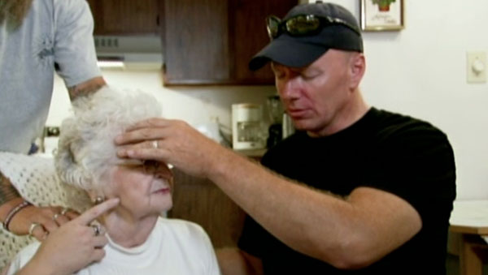
God is speaking through people?
Notes:
Is God speaking to clergy throughout the world? How do we know this is from God?

Slide 10

God is speaking directly to people?
Notes:
Do you believe it when people say they heard it from God?

Slide 11

The Bible is still speaking to us
Notes:
Does the Bible still hold lessons that speak to us? How do we know what part of the story we are supposed to learn? Example- Isreal would probably be considered a con artist, is that what God wants since he is one of the heroes of our story

Slide 12

The Christ Figure in Literature
In literature, a Christ figure needs to:
Notes:
One of the most famous literary device is the use of a Christ figure.

Slide 13
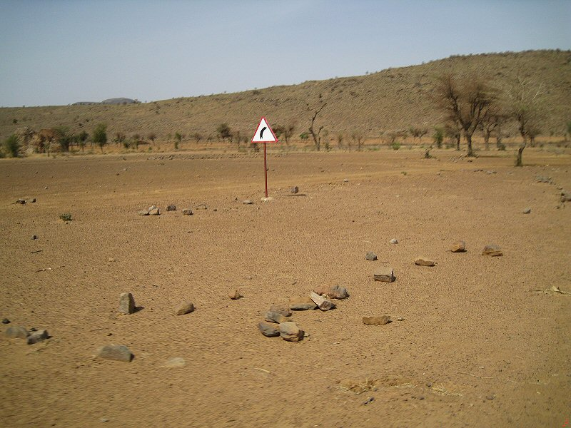
Come out of nowhere
Notes:
Christ just shows up and is NOT from noble background.

Slide 14

Do something for someone they can’t do for themselves
Notes:
Christ gives people salvation in the Bible which they can’t get for themselves.

Slide 15
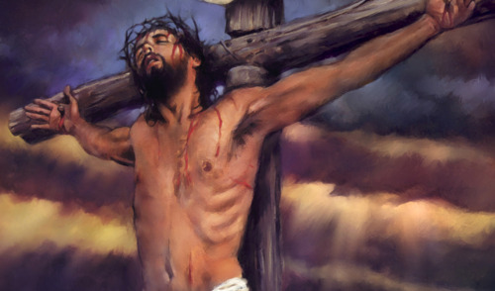
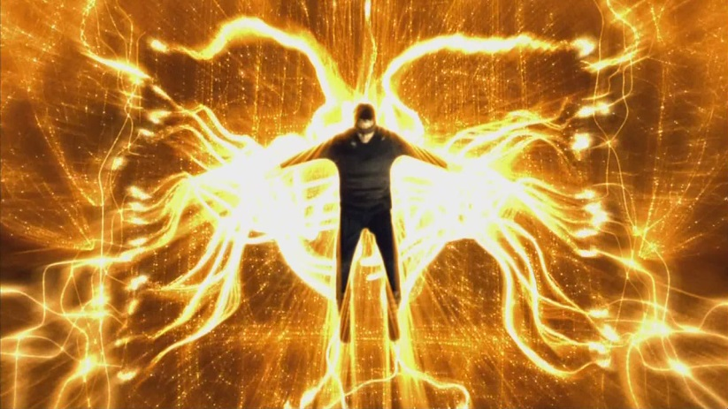
Goes away-usually dies
Notes:
The gift and the death are usually closely linked, the Christ figure’s death is usually what transforms people.

Slide 16

Leaves everyone transformed
Notes:
People always are different after the Christ figure has accomplished his mission.

Slide 17
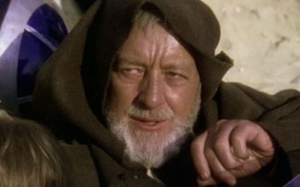
Example-Star Wars
Ben Kenobi
Notes:
There are many figures in literature but let’s use a movie for an easy example.

Slide 18
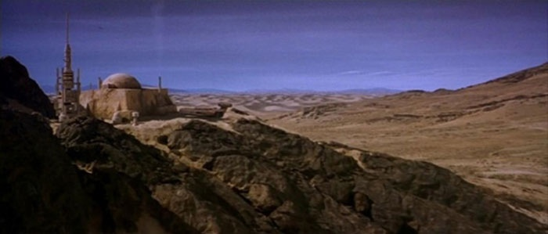
Living in no where planet
Notes:
Ben is living isolated in a cave on a no where planet.

Slide 19
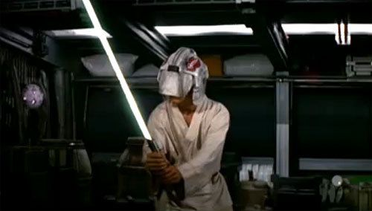
Teaches Luke to use his Jedi powers
Notes:
It is necessary for Ben to teach Luke how to use his gift, he doesn’t even know he has it.

Slide 20
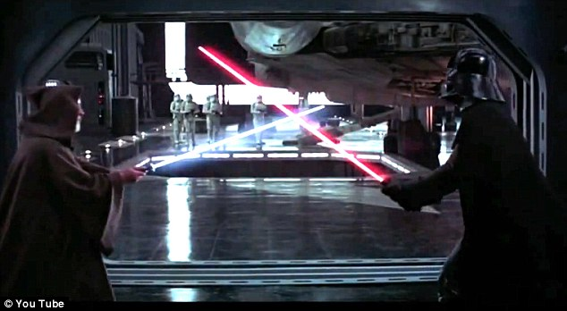
Dies
Notes:
Ben dies in front of Luke inspiring his resolve and transforming him into the hero.

Slide 21
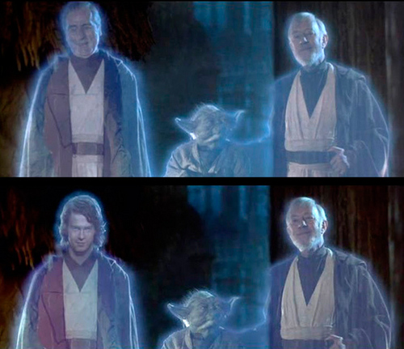
Transformed Luke to save the galaxy
In seen in vision by Luke when he frees galaxy
Notes:
This ending scene is no accident and supposed to be a transfiguration of his father and the two grand Jedi figures.

Slide 22
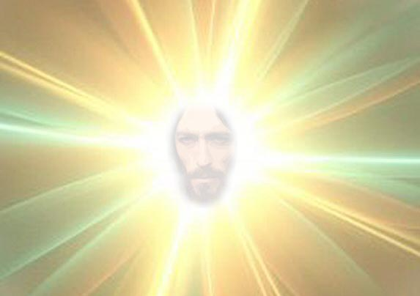
What are the author(s) trying to communicate?
Glittering Light
Notes:
Why does Jesus have glittering things? What is trying to be communicated?

Slide 23
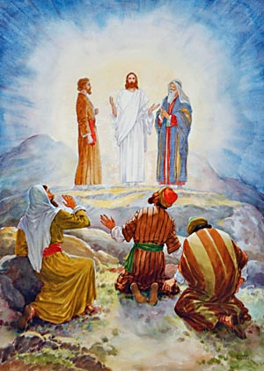
Elijah and Moses
Notes:
Why are Elijah and Moses picked? Elijah disappeared into the clouds and Moses is the main figure of transformation in the Hebrew faith. (In fact is a Christ figure too in literary terms.)

Slide 24
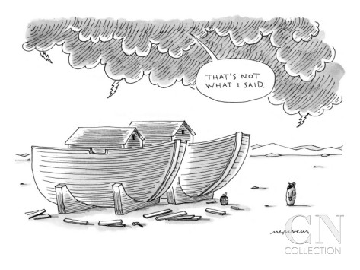
Voice from above
Notes:
The author never says who is talking, how do we know who it is?

Slide 25

What does Peter want?
Notes:
Why does Peter want to set up tents for everyone?

Slide 26

How would you write it?
Notes:
Even a true story leaves out parts and puts in other to allow the reader to “look” at the right parts.
Peter doesn’t mention the tents in his story.
What parts are important to you in this story?

Slide 27

A writer is trying to communicate a point in the context of their culture
Would you use the same type of devices?
Notes:
How would you communicate the points of the story in your cultural context?
Would your parents use different elements than you? How about other people that you know?
Explain the idea of a Rincon Fire Blog, Rincon Fire Skits, and other ways we will be putting these stories in our own cultural context.

